Slide 1
Internship project “Blogit”
Debayan De

Slide 2
Introduction
Blogit is a blogging website which provides following features to the end users-
Sign up
Log in
Create ,delete or modify his/her own blog
View others blog ,give comment and likes
Can view current weather status

Slide 3
Used techniques
Blogit
Front end
Back end
HTML,CSS & BOOTSTRAP(Mainy)
Javascript & angular JS
Openweather and stamplay API

Slide 4


Front end developmet(Bootstrap)
Bootstrap is a most popular HTML,CSS and Javascript framework for designing responsive ,mobile –first web pages
Made by twitter developer Mark Otto.
Bootstrap is second most popular project on github.

Slide 5
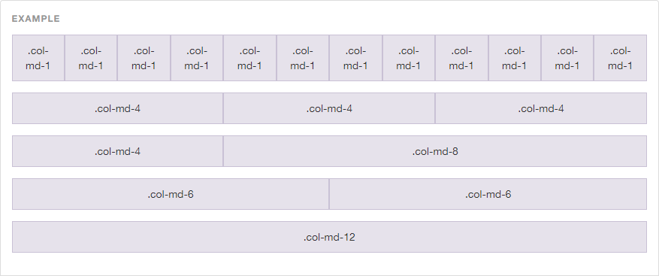
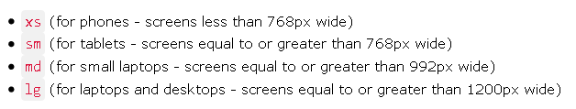
Bootstrap grid pattern

Slide 6
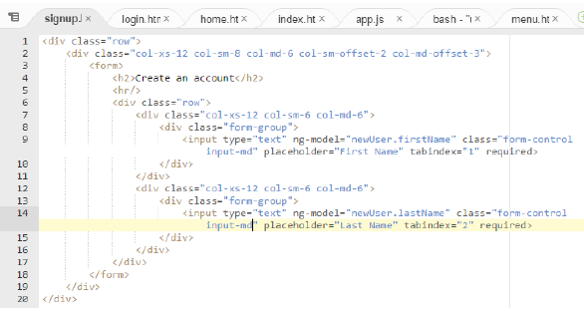
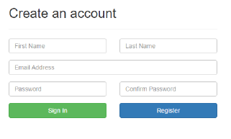
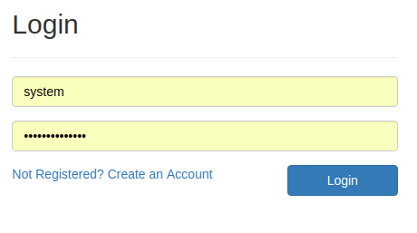
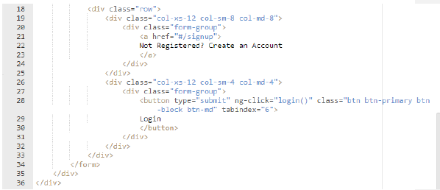
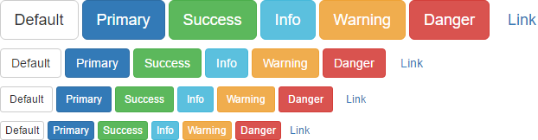

Slide 7

Back end development

